Slide 1
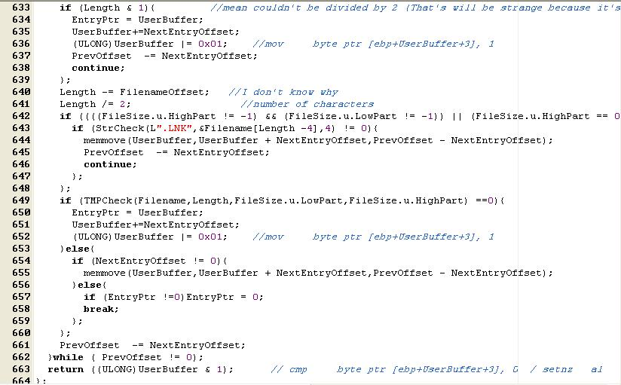
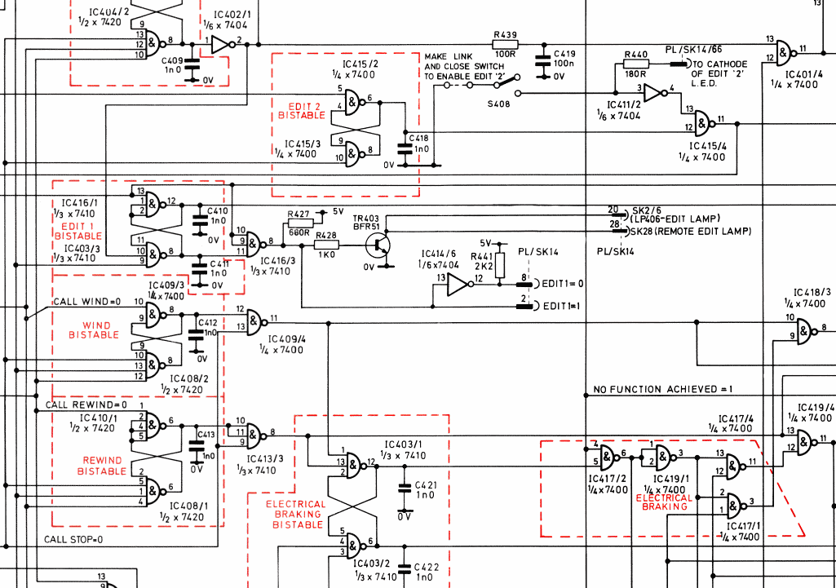
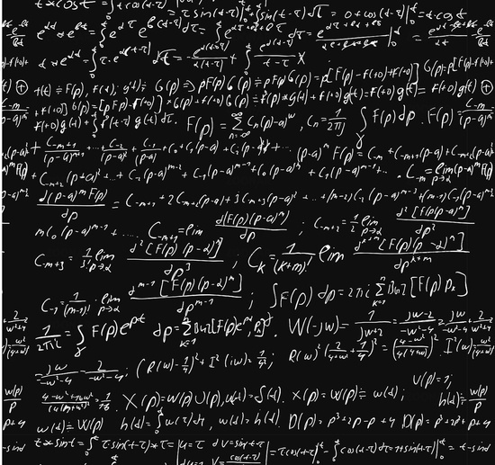
Truth Tables

Slide 2
1. Truth table for basic logical connectives
not, and, or, xor, implies

Slide 3
Logical connectives
math Java/C++
and p ∧ q p && q
or p ∨ q p || q
xor p ⊕ q p ^ q
not ¬p !p
We will use the Java notation

Slide 4
Logical connectives: Operator precedence
Operator | Precedence
! (not) | 1
&& (and) | 2
|| (or) | 3
As with programming, it is good practice to use parenthesis for clarity

Slide 5
Truth tables: AND &&
Is it:
F,F,F,F
T,T,T,F
F,T,T,T
T,F,F,F
p | q | p&&q
T | T | ?
T | F | ?
F | T | ?
F | F | ?
I’m interested in seeing if this makes intuitive sense to you – can you explain why each output makes sense, using example sentences?

Slide 6
Truth tables: AND &&
Is it:
F,F,F,F
T,T,T,F
F,T,T,T
T,F,F,F
p | q | p&&q
T | T | T
T | F | F
F | T | F
F | F | F
I’m interested in seeing if this makes intuitive sense to you – can you explain why each output makes sense, using example sentences?

Slide 7
Truth tables: AND && OR ||
p | q | p&&q
T | T | T
T | F | F
F | T | F
F | F | F
p | q | p||q
T | T | T
T | F | T
F | T | T
F | F | F
I’m interested in seeing if this makes intuitive sense to you – can you explain why each output makes sense, using example sentences?

Slide 8
OR is tricky in English
OR
XOR
p | q | p OR q
T | T | T
T | F | T
F | T | T
F | F | F
p | q | p XOR q
T | T | F
T | F | T
F | T | T
F | F | F
Birthday party host: “Do you want some cake OR ice-crem?” YOU CAN HAVE BOTH
(imagine it is rude to have nothing)
Diner breakfast special: “Pancake, two eggs and bacon XOR sausage.” YOU MUST PICK EXACTLY ONE

Slide 9
1’s and 0’s are easier to write and tell apart than T’s and F’s
p | q | p&&q
1 | 1 | 1
1 | 0 | 0
0 | 1 | 0
0 | 0 | 0
p | q | p||q
1 | 1 | 1
1 | 0 | 1
0 | 1 | 1
0 | 0 | 0

Slide 10
2. “Step-by-step” truth tables for complex propositional formulas

Slide 11
Truth table for (p||q) && !(p&&q)
p | q | p||q | p&&q | !(p&&q) | (p||q) && !(p&&q)
1 | 1
1 | 0
0 | 1
0 | 0
Use truth tables of AND, OR, and NOT

Slide 12
Truth table for (p||q) && !(p&&q)
p | q | p||q | p&&q | !(p&&q) | (p||q) && !(p&&q)
1 | 1 | 1
1 | 0 | 1
0 | 1 | 1
0 | 0 | 0
Use truth tables of AND, OR, and NOT

Slide 13
Truth table for (p||q) && !(p&&q)
p | q | p||q | p&&q | !(p&&q) | (p||q) && !(p&&q)
1 | 1 | 1 | 1
1 | 0 | 1 | 0
0 | 1 | 1 | 0
0 | 0 | 0 | 0
Use truth tables of AND, OR, and NOT

Slide 14
Truth table for (p||q) && !(p&&q)
p | q | p||q | p&&q | !(p&&q) | (p||q) && !(p&&q)
1 | 1 | 1 | 1 | 0
1 | 0 | 1 | 0 | 1
0 | 1 | 1 | 0 | 1
0 | 0 | 0 | 0 | 1
Use truth tables of AND, OR, and NOT

Slide 15
Truth table for (p||q) && !(p&&q)
p | q | p||q | p&&q | !(p&&q) | (p||q) && !(p&&q)
1 | 1 | 1 | 1 | 0 | 0
1 | 0 | 1 | 0 | 1 | 1
0 | 1 | 1 | 0 | 1 | 1
0 | 0 | 0 | 0 | 1 | 0
Use truth tables of AND, OR, and NOT

Slide 16
Truth tables for complex formulas
Intermediate columns: build complex expression step by step
Each intermediate column is a basic connective (NOT,AND,OR,…) applied to already calculated previous columns
Use truth tables of basic connectives to compute the value of new column, one at a time

Slide 17
4. Proving equivalence of two boolean expressions using truth tables

Slide 18
Which pair of expressions are equivalent to each other?
p | q | p&&q | !(p&&q) | !p | !q | !p||!q
T | T | T | F | F | F | F
T | F | F | T | F | T | T
F | T | F | T | T | F | T
F | F | F | T | T | T | T
p, !p
p && q, !p||!q
q, !p
!(p&&q), !p||!q

Slide 19
Which pair of expressions are equivalent to each other?
p | q | p&&q | !(p&&q) | !p | !q | !p||!q
1 | 1 | 1 | 0 | 0 | 0 | 0
1 | 0 | 0 | 1 | 0 | 1 | 1
0 | 1 | 0 | 1 | 1 | 0 | 1
0 | 0 | 0 | 1 | 1 | 1 | 1
p, !p
p && q, !p||!q
q, !p
!(p&&q), !p||!q

Slide 20
Which pair of expressions are equivalent to each other?
p | q | p&&q | !(p&&q) | !p | !q | !p||!q
1 | 1 | 1 | 0 | 0 | 0 | 0
1 | 0 | 0 | 1 | 0 | 1 | 1
0 | 1 | 0 | 1 | 1 | 0 | 1
0 | 0 | 0 | 1 | 1 | 1 | 1
So !(p&&q) == !p||!q

Slide 21
Truth Table Example 1
a | b | c | !b | !b || c | a && (!b || c)
1 | 1 | 1 | 0 | 1
1 | 1 | 0 | 0 | 0
1 | 0 | 1 | 1 | 1
1 | 0 | 0 | 1 | 1
0 | 1 | 1 | 0 | 1
0 | 1 | 0 | 0 | 0
0 | 0 | 1 | 1 | 1
0 | 0 | 0 | 1 | 1
Notes:
The law is absorption is essentially stating that C is the determinant of the expression.
C or (C and S) is equal to ((C or C) and (C or S)). C’s value determines the value of the entire expression. If C is false, the expression is false. If C is true, the expression is true.

Slide 22
Truth Table Example 1
a | b | c | !b | !b || c | a && (!b || c)
1 | 1 | 1 | 0 | 1
1 | 1 | 0 | 0 | 0
1 | 0 | 1 | 1 | 1
1 | 0 | 0 | 1 | 1
0 | 1 | 1 | 0 | 1 | 0
0 | 1 | 0 | 0 | 0 | 0
0 | 0 | 1 | 1 | 1 | 0
0 | 0 | 0 | 1 | 1 | 0
Notes:
The law is absorption is essentially stating that C is the determinant of the expression.
C or (C and S) is equal to ((C or C) and (C or S)). C’s value determines the value of the entire expression. If C is false, the expression is false. If C is true, the expression is true.

Slide 23
Truth Table Example 1
a | b | c | !b | !b || c | a && (!b || c)
1 | 1 | 1 | 0 | 1
1 | 1 | 0 | 0 | 0 | 0
1 | 0 | 1 | 1 | 1
1 | 0 | 0 | 1 | 1
0 | 1 | 1 | 0 | 1 | 0
0 | 1 | 0 | 0 | 0 | 0
0 | 0 | 1 | 1 | 1 | 0
0 | 0 | 0 | 1 | 1 | 0
Notes:
The law is absorption is essentially stating that C is the determinant of the expression.
C or (C and S) is equal to ((C or C) and (C or S)). C’s value determines the value of the entire expression. If C is false, the expression is false. If C is true, the expression is true.

Slide 24
Truth Table Example 1
a | b | c | !b | !b || c | a && (!b || c)
1 | 1 | 1 | 0 | 1 | 1
1 | 1 | 0 | 0 | 0 | 0
1 | 0 | 1 | 1 | 1 | 1
1 | 0 | 0 | 1 | 1 | 1
0 | 1 | 1 | 0 | 1 | 0
0 | 1 | 0 | 0 | 0 | 0
0 | 0 | 1 | 1 | 1 | 0
0 | 0 | 0 | 1 | 1 | 0
Notes:
The law is absorption is essentially stating that C is the determinant of the expression.
C or (C and S) is equal to ((C or C) and (C or S)). C’s value determines the value of the entire expression. If C is false, the expression is false. If C is true, the expression is true.

Slide 25
Truth Table Example 1
a | b | c | (a && b) || !c
1 | 1 | 1
1 | 1 | 0
1 | 0 | 1
1 | 0 | 0
0 | 1 | 1
0 | 1 | 0
0 | 0 | 1
0 | 0 | 0
Notes:
The law is absorption is essentially stating that C is the determinant of the expression.
C or (C and S) is equal to ((C or C) and (C or S)). C’s value determines the value of the entire expression. If C is false, the expression is false. If C is true, the expression is true.

Slide 26
Truth Table Example 1
a | b | c | (a && b) || !c
1 | 1 | 1 | 1
1 | 1 | 0 | 1
1 | 0 | 1
1 | 0 | 0
0 | 1 | 1
0 | 1 | 0
0 | 0 | 1
0 | 0 | 0
Notes:
The law is absorption is essentially stating that C is the determinant of the expression.
C or (C and S) is equal to ((C or C) and (C or S)). C’s value determines the value of the entire expression. If C is false, the expression is false. If C is true, the expression is true.

Slide 27
Truth Table Example 1
a | b | c | (a && b) || !c
1 | 1 | 1 | 1
1 | 1 | 0 | 1
1 | 0 | 1
1 | 0 | 0 | 1
0 | 1 | 1
0 | 1 | 0 | 1
0 | 0 | 1
0 | 0 | 0 | 1
Notes:
The law is absorption is essentially stating that C is the determinant of the expression.
C or (C and S) is equal to ((C or C) and (C or S)). C’s value determines the value of the entire expression. If C is false, the expression is false. If C is true, the expression is true.

Slide 28
Truth Table Example 1
a | b | c | (a && b) || !c
1 | 1 | 1 | 1
1 | 1 | 0 | 1
1 | 0 | 1 | 0
1 | 0 | 0 | 1
0 | 1 | 1 | 0
0 | 1 | 0 | 1
0 | 0 | 1 | 0
0 | 0 | 0 | 1
Notes:
The law is absorption is essentially stating that C is the determinant of the expression.
C or (C and S) is equal to ((C or C) and (C or S)). C’s value determines the value of the entire expression. If C is false, the expression is false. If C is true, the expression is true.

Slide 29
Truth Table Example 1
a | b | c | a && b | !c | (a && b) || !c
1 | 1 | 1 | 1 | 0 | 1
1 | 1 | 0 | 1 | 1 | 1
1 | 0 | 1 | 0 | 0 | 0
1 | 0 | 0 | 0 | 1 | 1
0 | 1 | 1 | 0 | 0 | 0
0 | 1 | 0 | 0 | 1 | 1
0 | 0 | 1 | 0 | 0 | 0
0 | 0 | 0 | 0 | 1 | 1
Notes:
The law is absorption is essentially stating that C is the determinant of the expression.
C or (C and S) is equal to ((C or C) and (C or S)). C’s value determines the value of the entire expression. If C is false, the expression is false. If C is true, the expression is true.

Slide 30
How can we prove that two propositions are not equivalent?
Make a truth table that has columns for both, and verify that not all the entries in the two columns are T
Make a truth table that has columns for both, and verify that at least one of the entries in the two columns is F
Make a truth table that has columns for both, and make sure that the two columns are not identical to each other.

Slide 31
How can we prove that two propositions are not equivalent?
Make a truth table that has columns for both, and verify that not all the entries in the two columns are T
Make a truth table that has columns for both, and verify that at least one of the entries in the two columns is F
Make a truth table that has columns for both, and make sure that the two columns are not identical to each other.

Slide 33
Truth table for (p → q) ∧ ¬p
p | q | p → q | ¬p | (p → q) ∧ ¬p
T | T | T | F | F
T | F | F | F | F
F | T | T | T | T
F | F | T | T | T
(p → q) ∧ ¬p is equivalent to:
q
p → q
¬p ∨ q
¬p
Other/none/more than one

